Slide 1
My town, my country
LUČANI, SERBIA

Slide 2
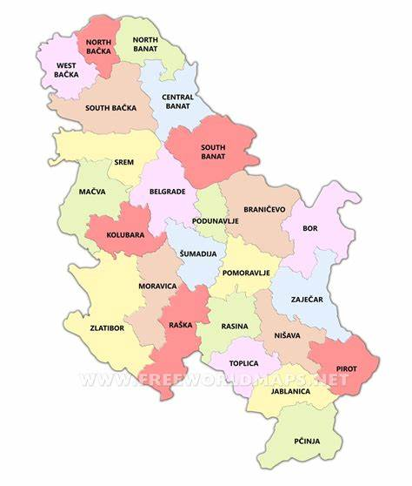
The content:
My town:
-Lucani is a small town where
. 5 142 people live
-In our town we have paint industries and a
factory named “Milan Blagojevic namenska”
-In our town we also practice sports as karate,
basketball, volleyball and football

Slide 3
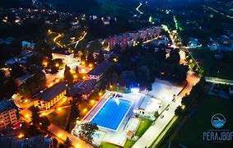
My town Lučani-Location and population
Lučani (Serbian Cyrillic: Лучани) is a town and municipality located in the Moravica District of western Serbia. The population of the town is 5,142, while the population of the municipality is 20,897.

Slide 4
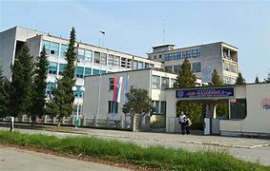
My town Lučani-Industry
Lučani is home to the chemical company Milan Blagojević - Namenska which employs around 1,300 people (as of 2017). Also, Maxima color manufacturer has its factory in Lučani.

Slide 5
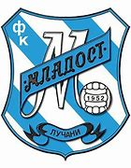
My town Lučani-Sports
Lučani is a home to the professional football club FK Mladost Lučani, which has played continuously in the Serbian SuperLiga, the top division of Serbian football.

Slide 6

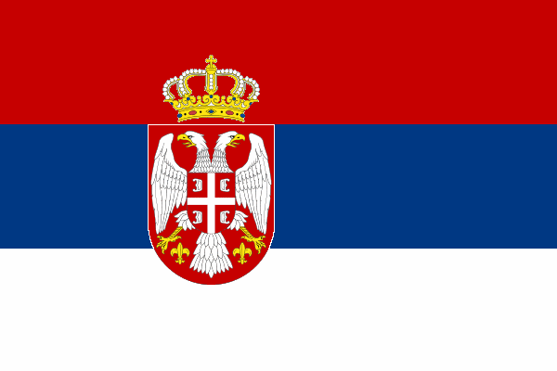
I live in Serbia
-Serbia is a country of 6,892 million people. The capital city is Belgrade. Serbia is a beautiful country with great people, nature and sights.
-Also Serbia is known as the country with really nice tradition and culture.

Slide 7
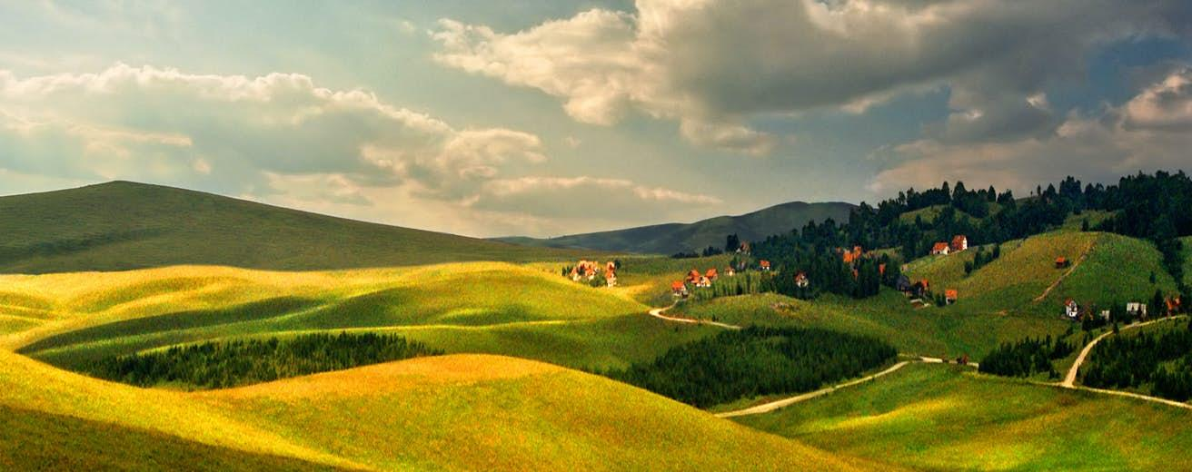
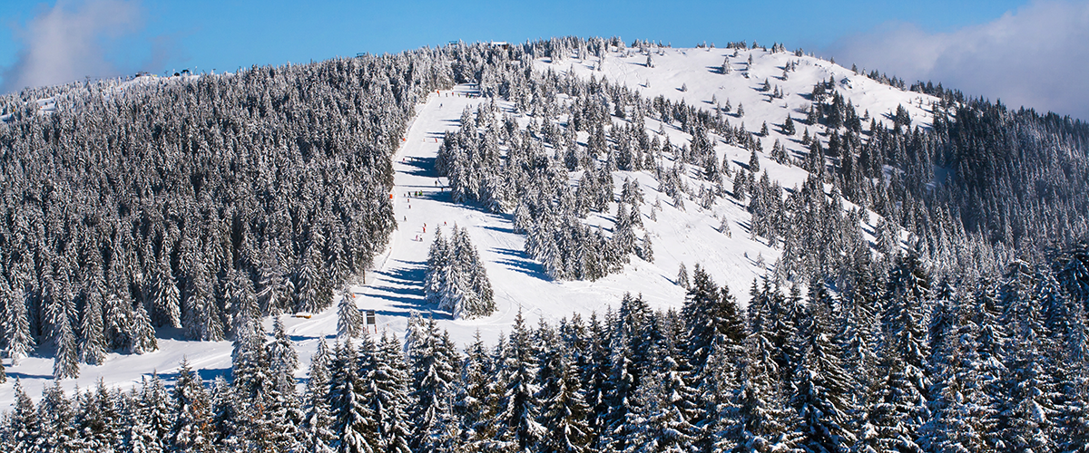
Best tourist places in Serbia
-Most visited sights in Serbia are: Zlatibor, Kopaonik, Tara, Perucac, Ovcar Banja, Golubacka tvrdjava, etc…

Slide 8
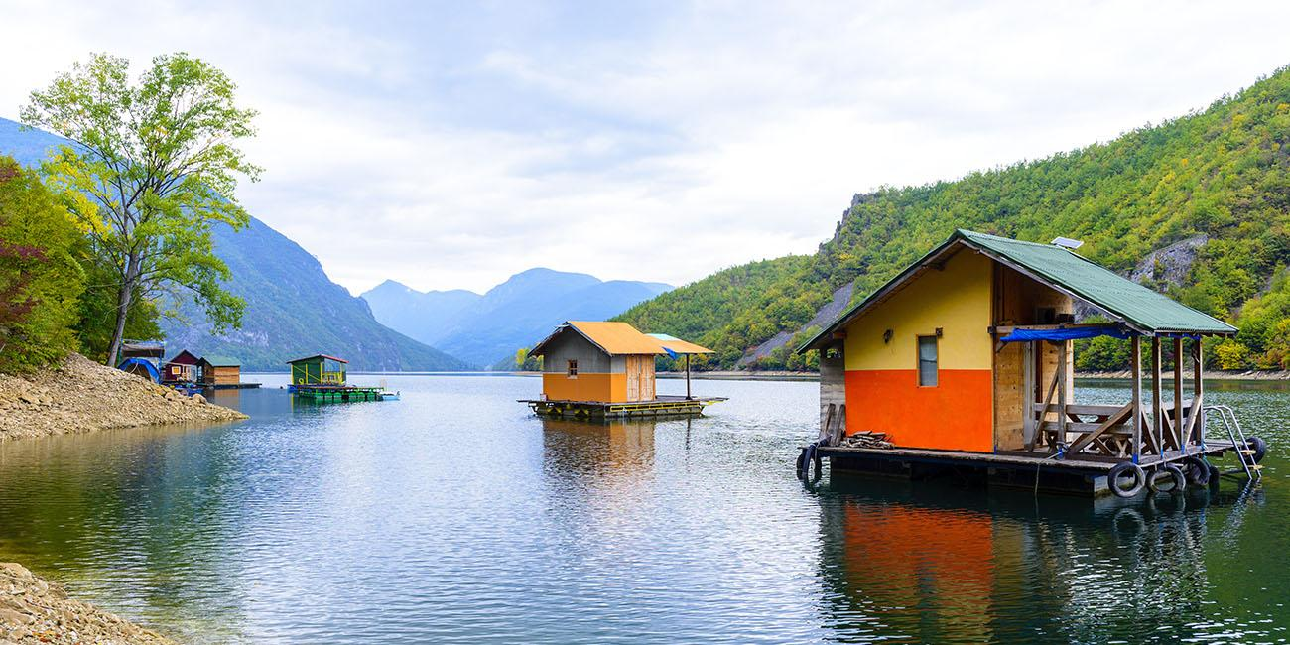
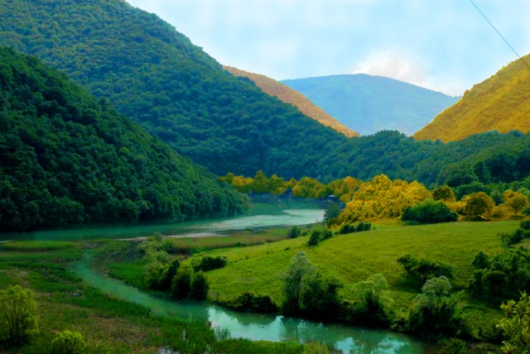
Perucac, Ovcar Banja

Slide 9
Cultural heritage
-On the UNESCO list of intangible cultural heritage there are three goods from Serbia- gusle, kolo and slava
-Gusle is a traditional Serbian string instrument. This instrument has one, or possibly two strings. They are usually made of maple wood.
-Kolo is a kind of collective folk game. As a part of the performing arts, it is present on the territory of the whole of Serbia, and the Serbian Orthodox population considers it a sign of national identity, it is also performed by other ethnic communities.
-Slava also known as krsna slava is a Serbian folk-church custom even after Easter and Christmas, the third most important family holiday, always associated with the day of a certain Christian saint.

Slide 10
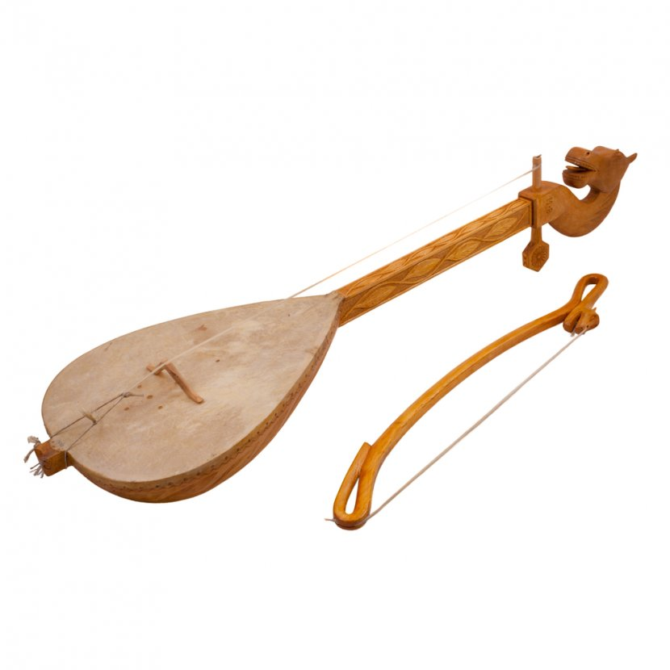
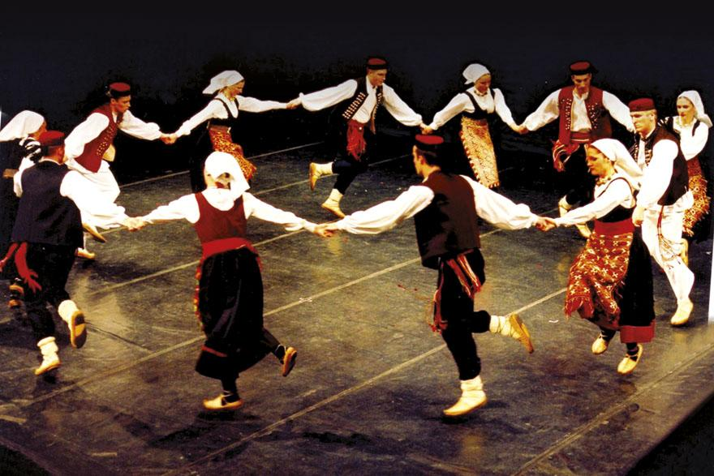
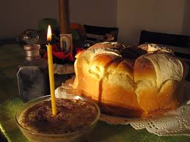
Gusle, kolo and Slava

Slide 11
Serbian cuisine
-Traditional Serbian dishes are: kacamak, sarma, kajmak, prsuta, pasulj, etc…
-Sarma is a dish made with meat and sauerkraut.
-Kacamak is a dish made of ground white corn.
-Kajmak is also a dish made of boiled milk.
-Prsuta is dried meat.
-Pasulj is a dish made of cooked beans and dried meat.

Slide 12
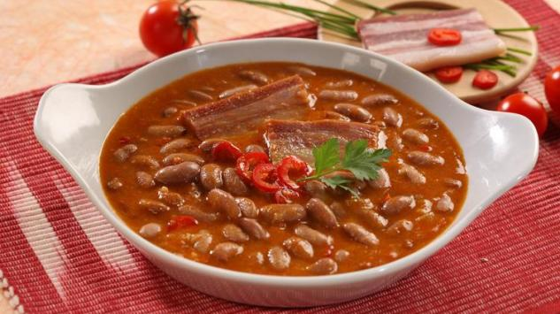
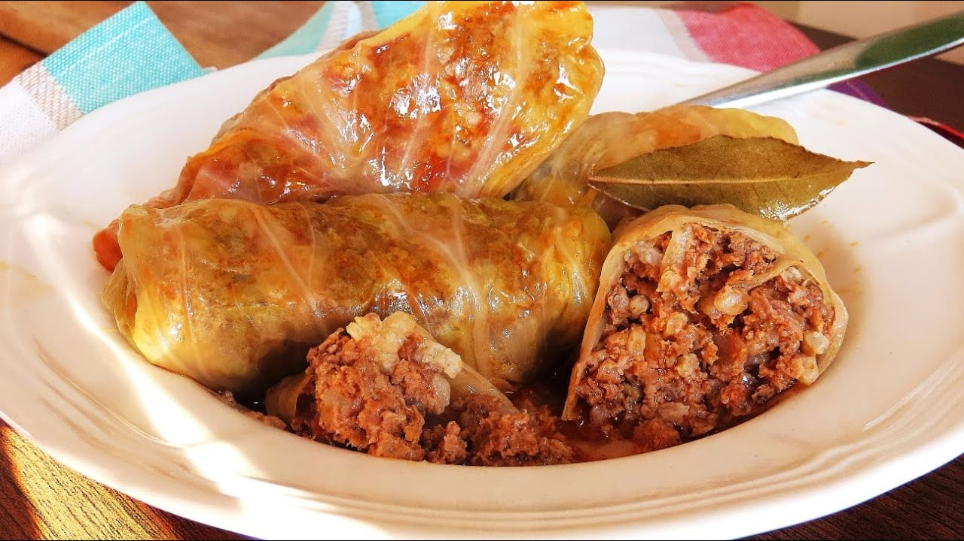
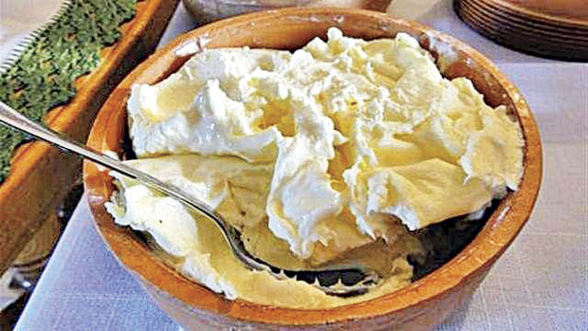
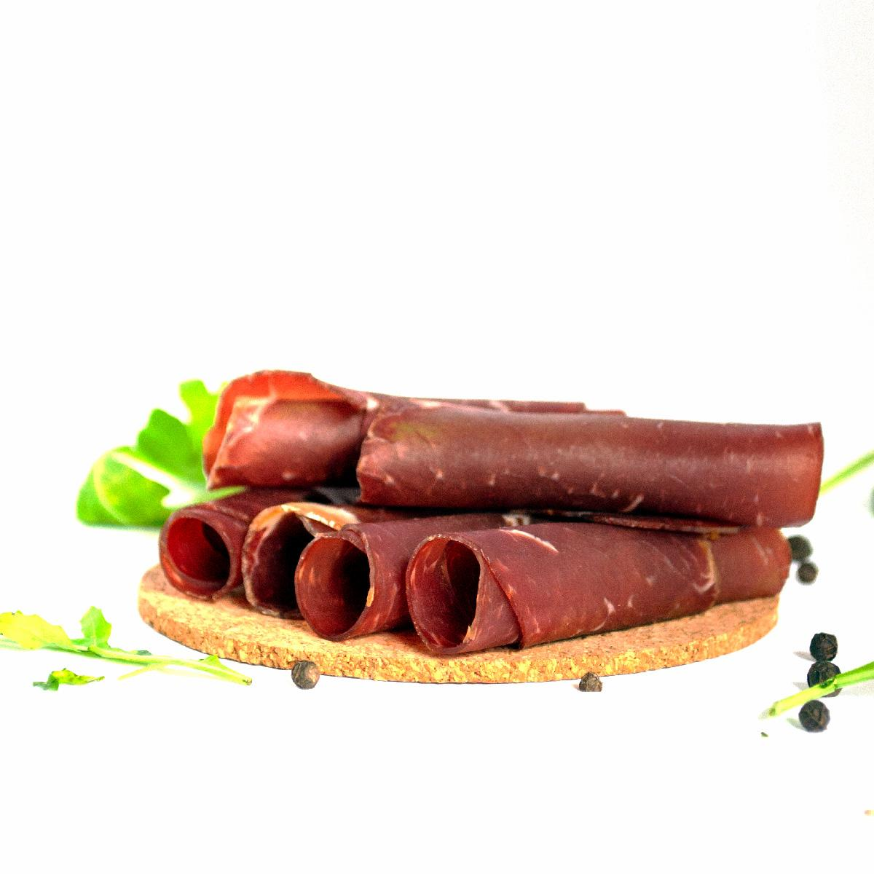
Sarma, kajmak, prsuta, kacamak, pasulj

