Slide 1
TURKEY-IZMIR-KARŞIYAKA
TURKBIRLIGI PRIMARY SCHOOL

Slide 2
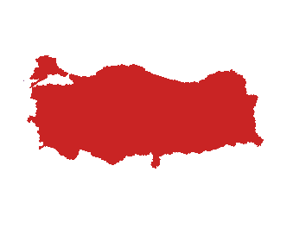
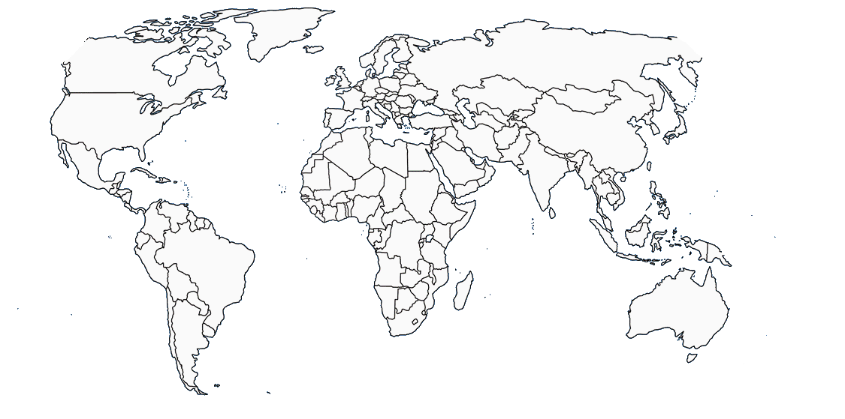
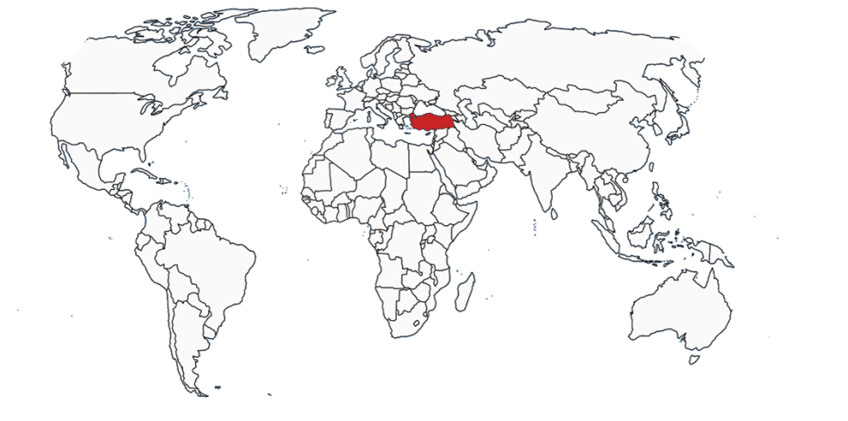
TURKEY
Turkey is a bridge between EUROPE and ASIA

Slide 3
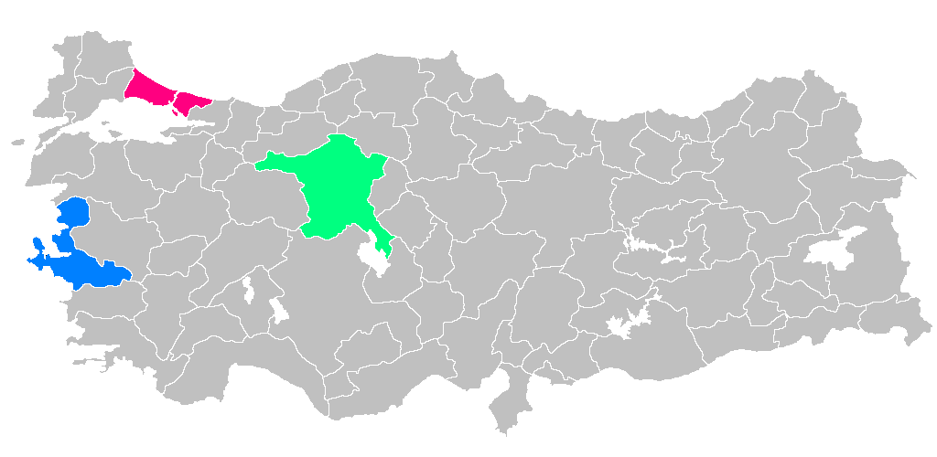
THE MOST IMPORTANT CITIES
İstanbul is the most famous and biggest city
Ankara is the capital city of Turkey
İzmir (where we are coming) is the third biggest city

Slide 4
Istanbul where the two continents meet each other
BOSPHORUS BRIDGE /ISTANBUL
Notes:
Istanbul where the two continents meet each other. It’s the only city in the world built on two continents between Europe and Asia connecting the Black Sea and Marmara Sea.

Slide 5
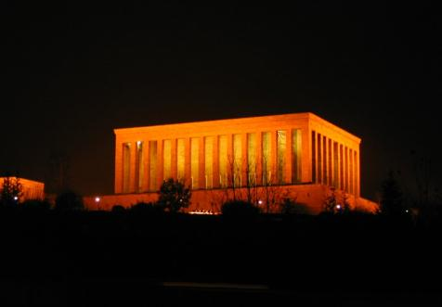
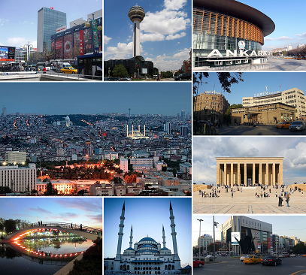
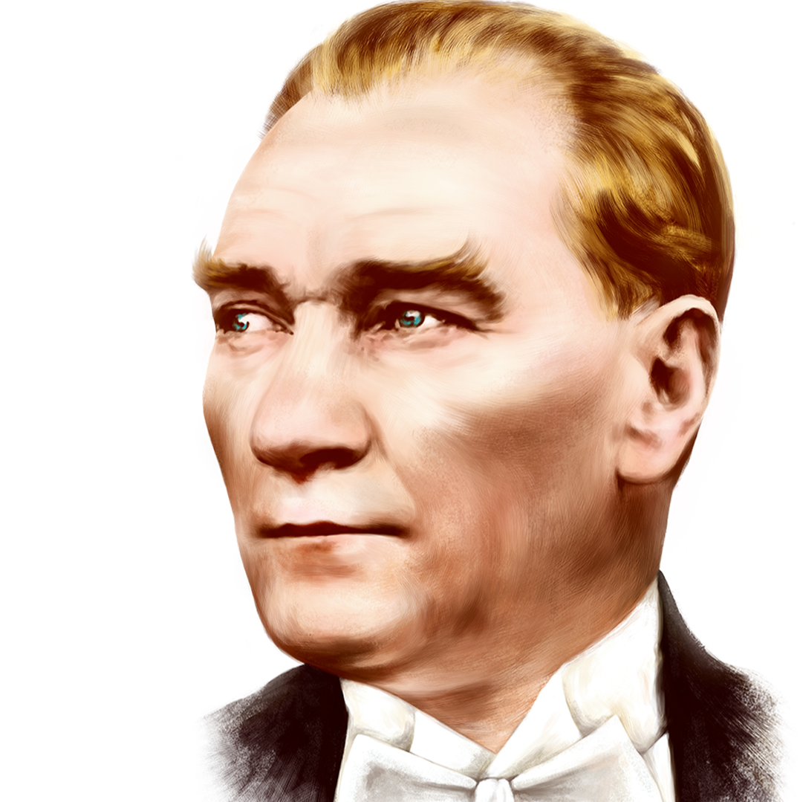
Ankara is the capital city of Turkey, this is Anıtkabir where Atatürk is buried.
ANITKABİR/ANKARA
Notes:
Ankara is the capital city of Turkey, this is Anıtkabir where Atatürk is buried.

Slide 6
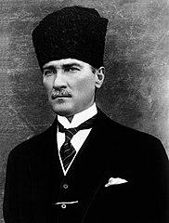
MUSTAFA KEMAL ATATÜRK
Atatürk who is called as father of Turks, led The Turkish War of Independence and after victory he founded Turkish Republic in 1923 and served as a president until his death-1938.
Atatürk is commemorated by many memorials and places named in his honor in Turkey

Slide 7
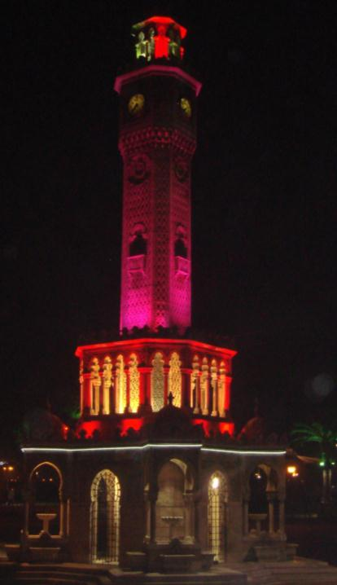
IZMIR
Notes:
İzmir where we live and which has a history of 5000 years and its old name was Smyrna

Slide 8
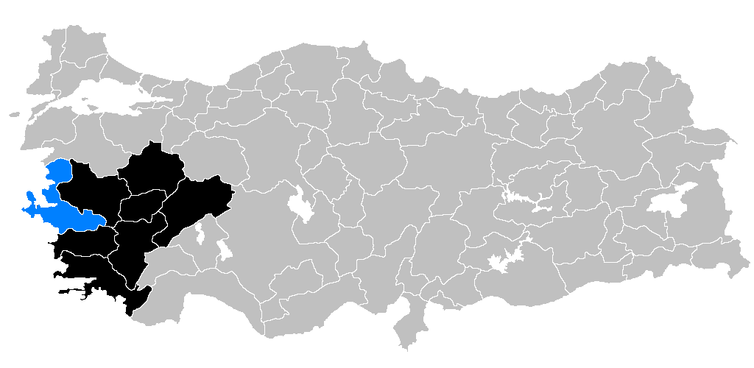
İzmir is located in the western part of Turkey.

Slide 9
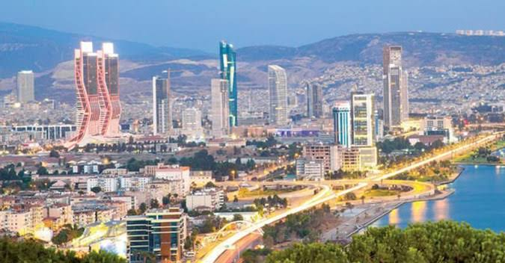
Izmir is a city on Turkey’s Aegean coast. Known as Smyrna in antiquity, it was founded by the Greeks, taken over by the Romans and rebuilt by Alexander the Great before becoming part of the Ottoman Empire in the 15th century.

Slide 10
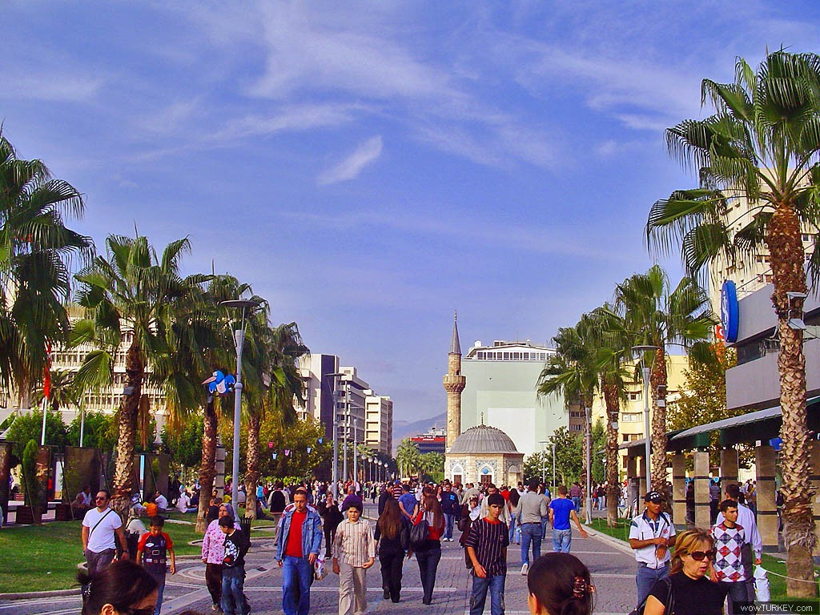
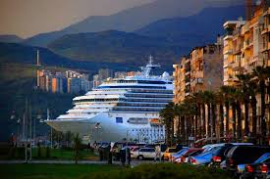
İzmir is…
very old city with 8000 years of history.
called as The Pearl of Aegean Region.
the third most crowded city in Turkey with 4,3 million
and it is the second largest port city.

Slide 11
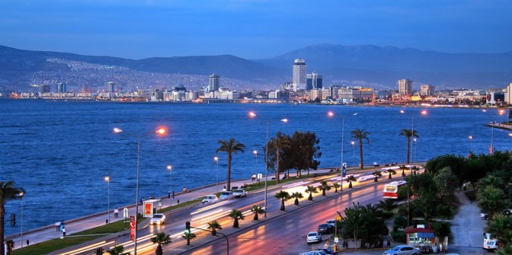
İZMİR BAY/IZMIR
Notes:
The Gulf of İzmir is on the Aegean Coast and it is an important Turkish Seaport.

Slide 12
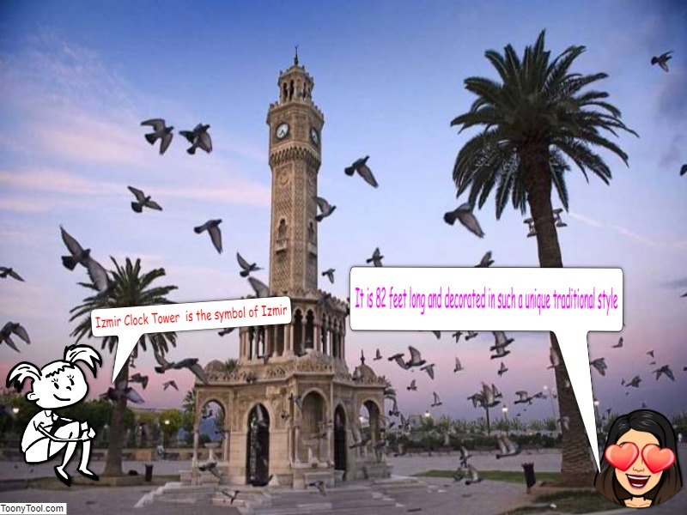
symbol of İzmir
CLOCK TOWER/IZMIR
You can see the famous clock tower in the centre of Izmir which is 109 years old. It has become a symbol of İzmir.
Notes:
You can see the famous clock tower in the centre of Izmir which is 109 years old. It has become a symbol of İzmir.

Slide 13
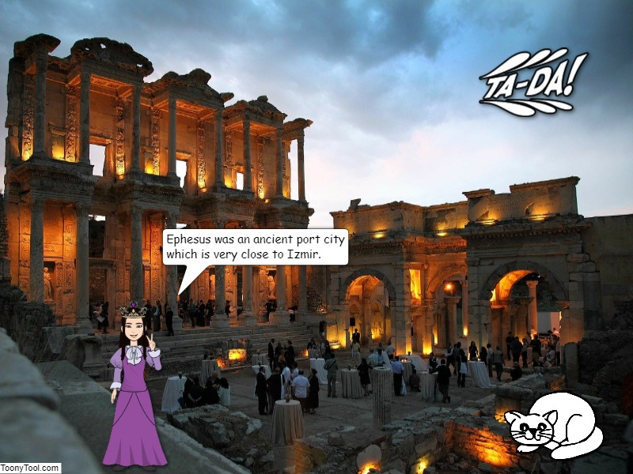
Ephesus was an ancient Greek city, and later a major Roman city, which is not far away form Izmir The city was famous for the Temple of Artemis (completed around 550 BC), one of the Seven Wonders of the Ancient World.
EPHESUS/İZMİR
Notes:
Ephesus was an ancient Greek city, and later a major Roman city, which is not far away form Izmir The city was famous for the Temple of Artemis (completed around 550 BC), one of the Seven Wonders of the Ancient World.

Slide 14
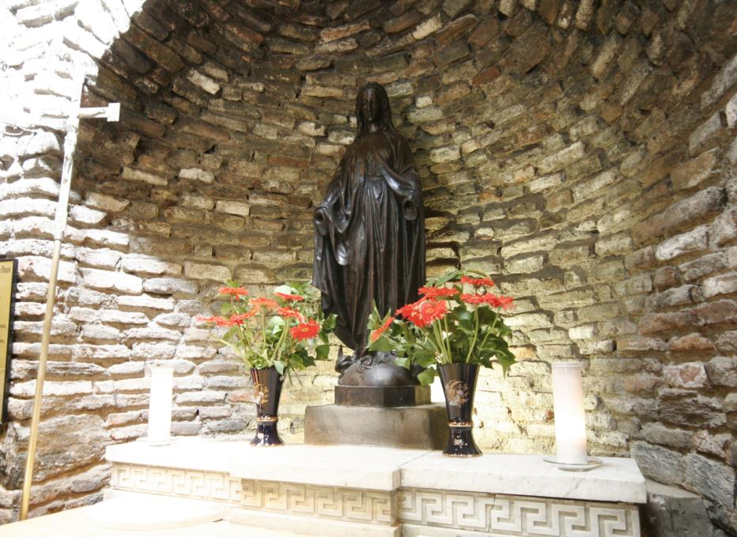
The House of Virgin Mary is a Christian an Muslim Temple which is believed by many people that Mary the mother of Jesus was taken to this house and lived there.
HOUSE OF VIRGIN MARY /IZMİR
Notes:
The House of Virgin Mary is a Christian an Muslim Temple which is believed by many people that Mary the mother of Jesus was taken to this house and lived there.

Slide 15
The Historical ELEVATOR

Slide 16
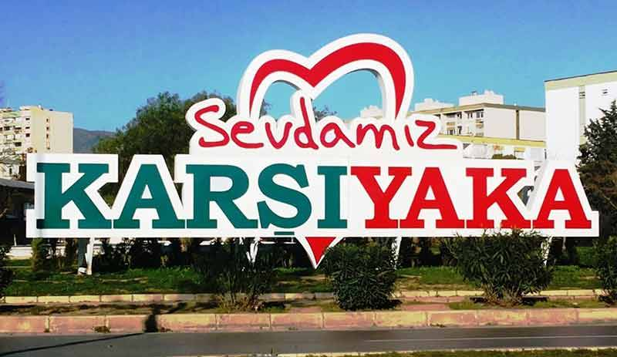
INTRODUCTION TO KARŞIYAKA
Karşıyaka means “the opposite shore”

Slide 17
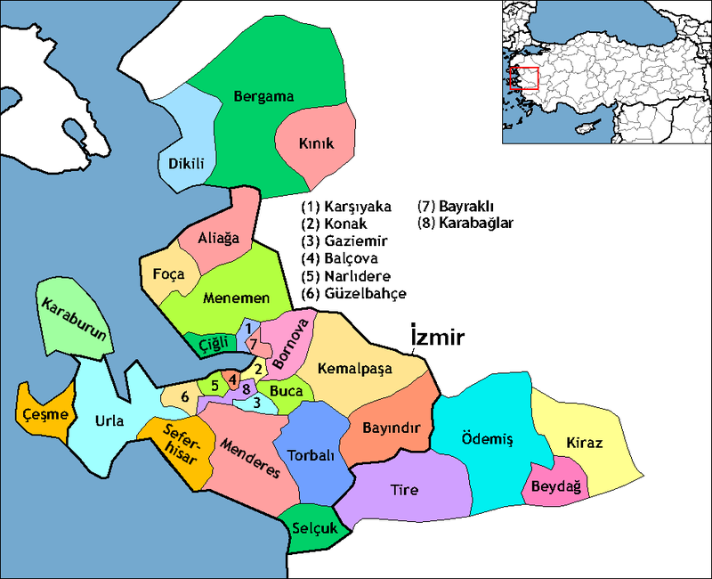
Karşıyaka is near the İzmir Bay
It is the Second largest district of İzmir

Slide 18
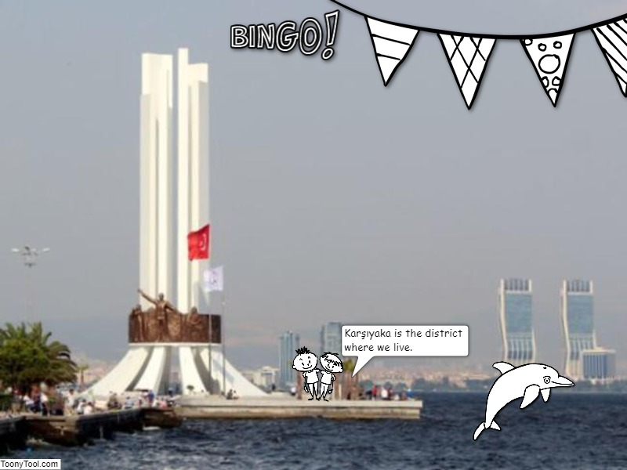

Slide 19
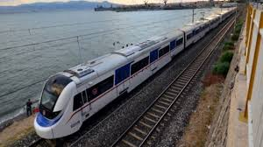
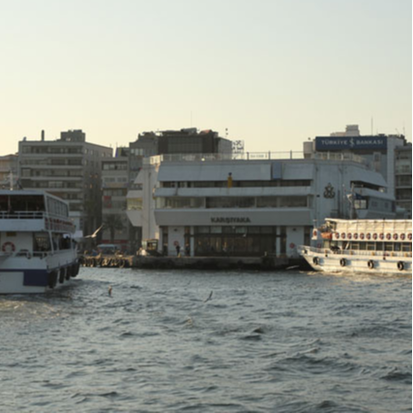
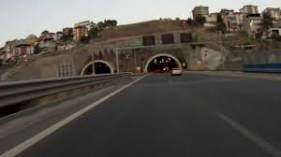
Since our district located on Izmir Bay,
We usually use marine transportation….
And also you can use
railway and highway
Sevinç

Slide 20
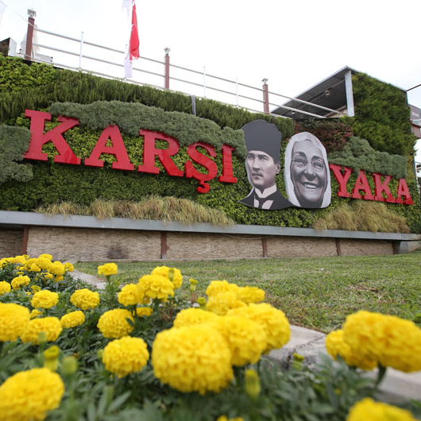
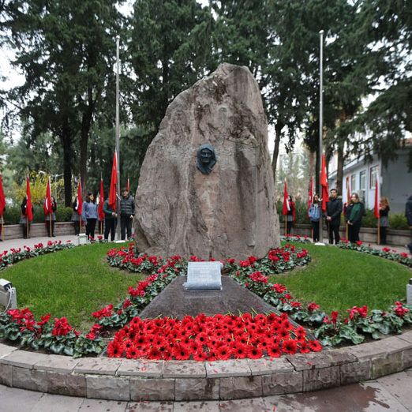
Karşıyaka is very important
town in İzmir for Turkish History.
The tomb of Zübeyde Hanım
who is mother of Atatürk is in Karşıyaka
Sevinç

Slide 21
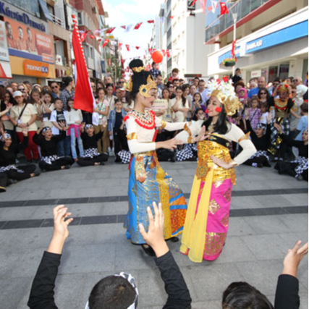
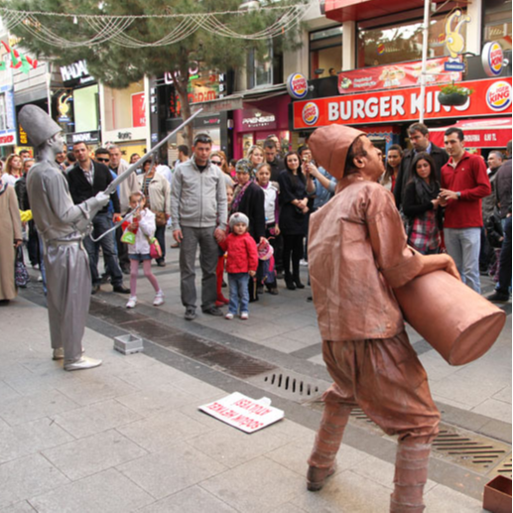
Karşıyaka is funny town in İzmir.
There are a lot of bazaars, shopping centers,
museums, cafes and restaurants….
Karsıyaka Bazaar
Sevinç

Slide 22
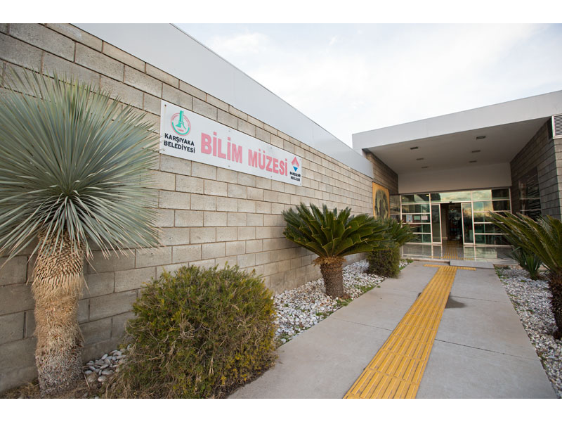
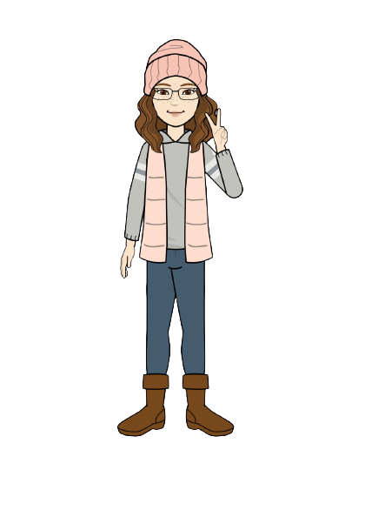
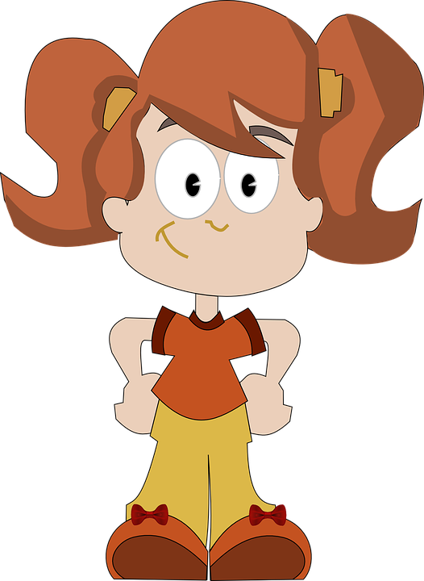
In our town children are so important..
There are many scientific areas and museums for them.
I love science
Science Museum
Sevinç

Slide 23
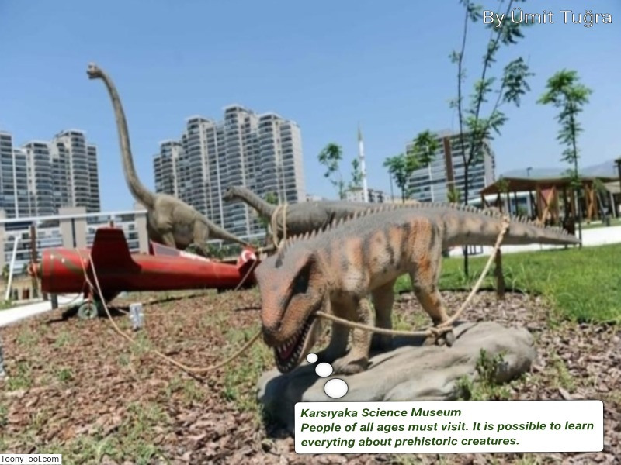

Slide 24
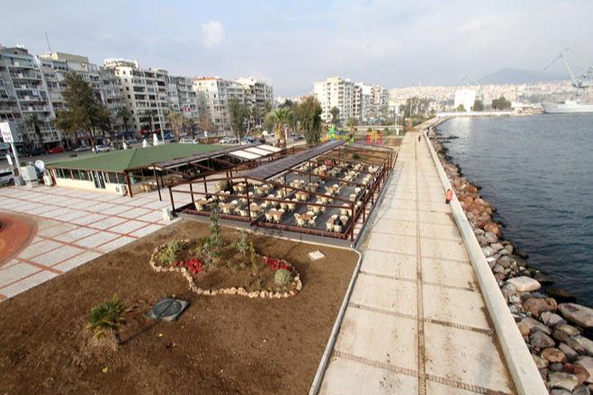
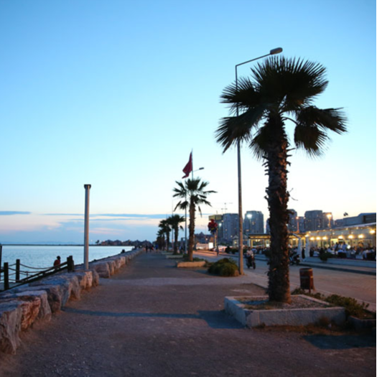
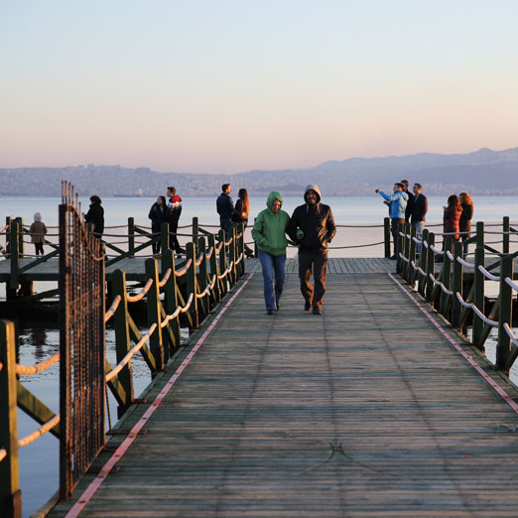
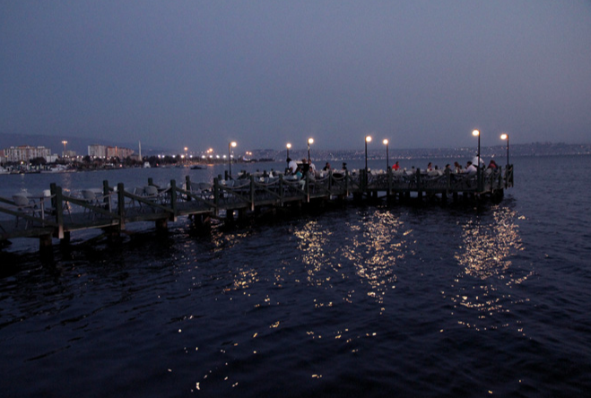
Karşıyaka is a seaside town in İzmir.

Slide 25
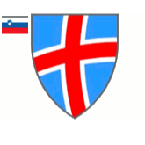
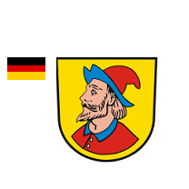
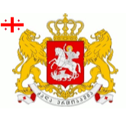
Sister Cities of Karşıyaka
CASCAIS
PORTUGAL
LOUDON COUNTRY
THE USA
WUXİ
CHINA
PIRAN
SLOVENIA
ZENICA
BOSNIA
HEIDENHEIM
GERMANY
KUTAISI
GEORGIA
PRIZREN
KOSOVO

Slide 26
Sister Cities of Karşıyaka
CASCAIS
PORTUGAL
LOUDON COUNTRY
THE USA
WUXİ
CHINA
PIRAN
SLOVENIA
ZENICA
BOSNIA
HEIDENHEIM
GERMANY
KUTAISI
GEORGIA
PRIZREN
KOSOVO

Slide 29
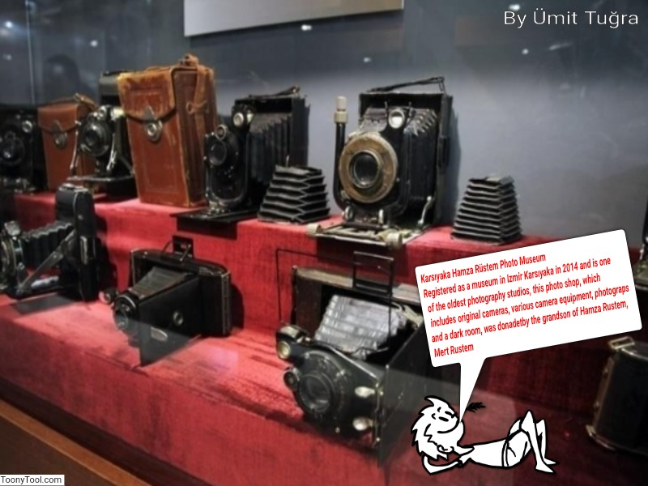

Slide 31
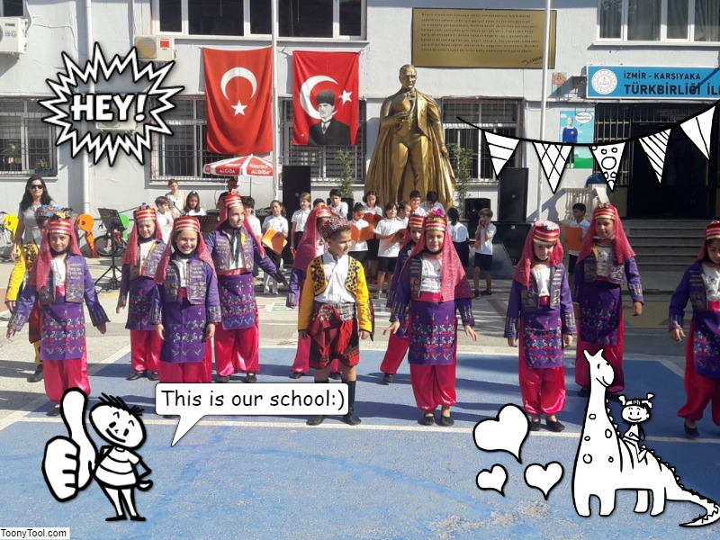
KARŞIYAKA TÜRKBİRLİĞİ İLKOKULU

Slide 32
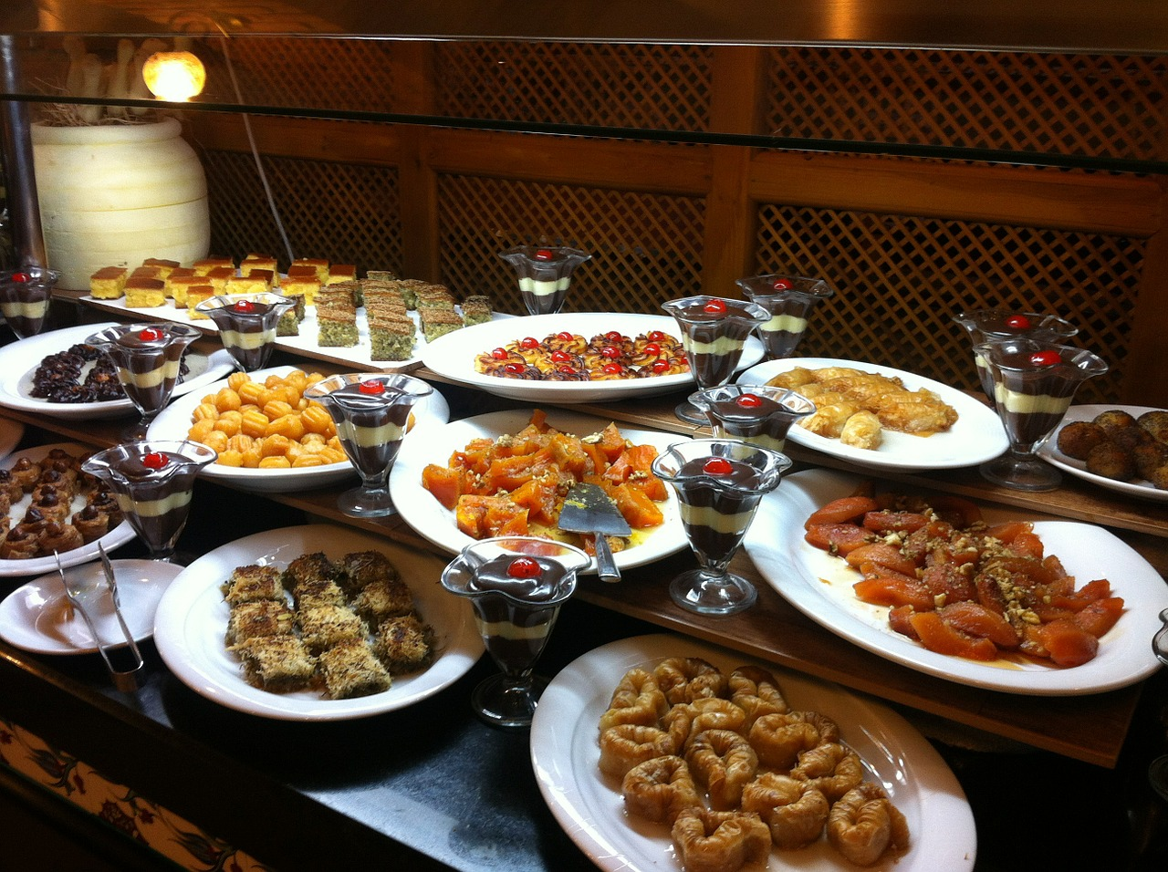
TRADITIONAL TURKISH FOOD

Slide 33
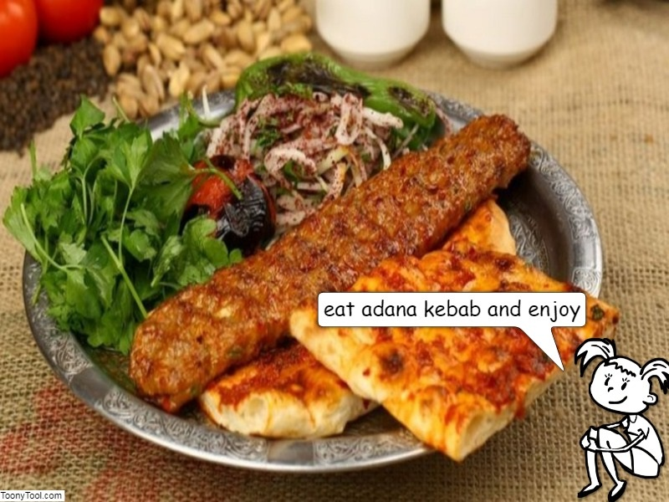
Beren

Slide 34
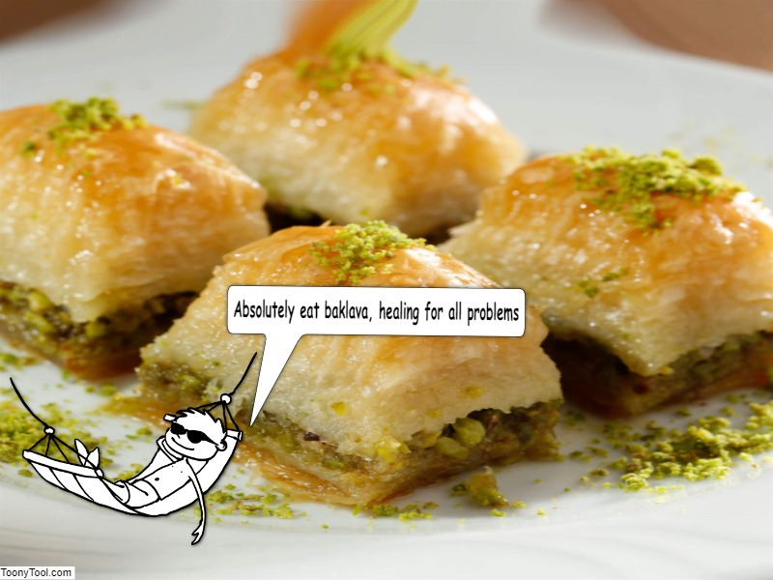
Eren

Slide 35
Zeynep

Slide 36
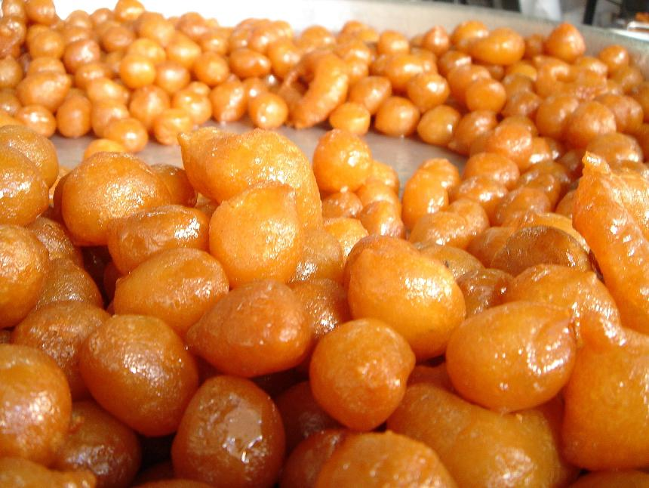
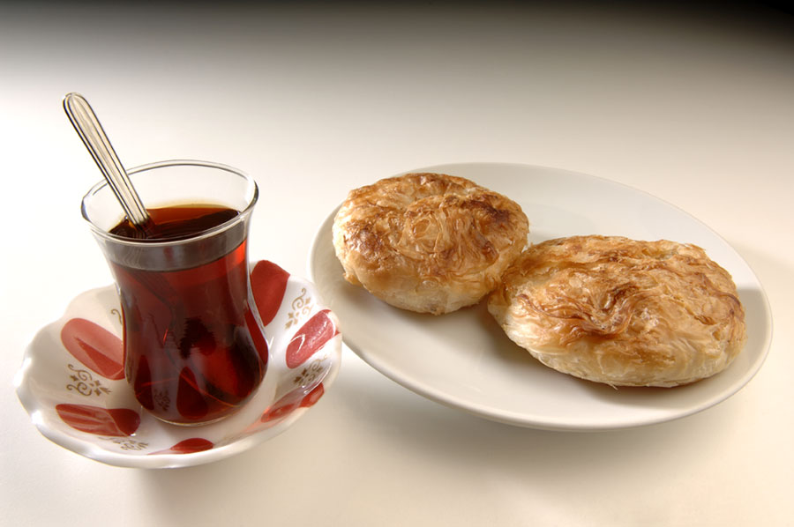
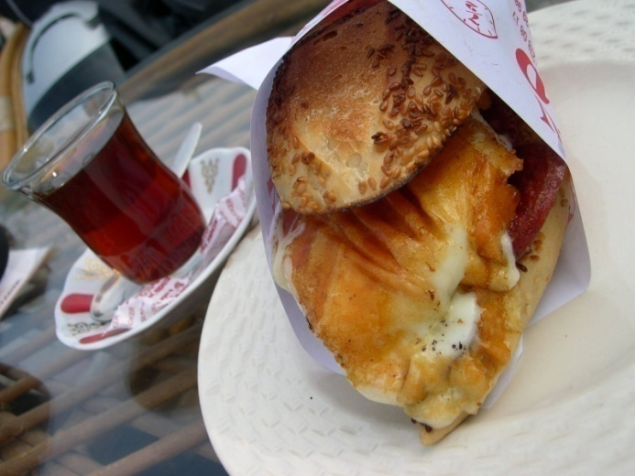
TRADITIONAL FOOD OF IZMIR
Lokma
Boyoz
Kumru
A KIND OF
DESSERT
A Kind of
Patty
A Kind of
Fast Food

Slide 37
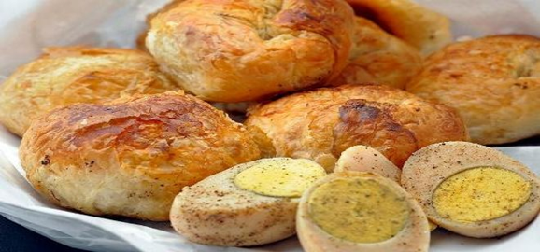
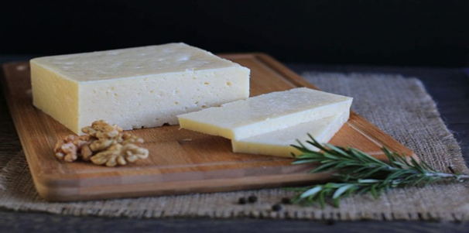
BOYOZ
It is a taste belongs to İzmir. It is a pastry consumed at breakfast. Boyoz, boiled eggs and tea are indispensable for the people of İzmir.
İZMİR TULUMU-İzmir Cheese
It is one of the preferred taste of breakfasts. It is made of sheep's milk.
Gülce &Elif

Slide 38
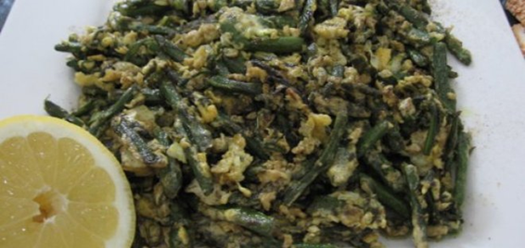
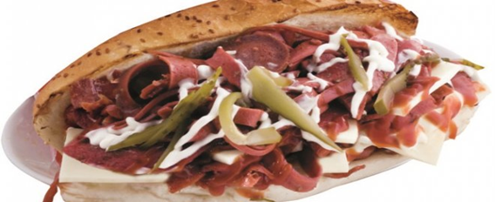
KUŞKONMAZ KAVURMASI-roasted asparagus
KUMRU
It's a green vegetable. It's roasted with blended spices.İzmir asparagus is very famous.We consume it at the breakfast and dinner.
It is a type of sandwich belongs to İzmir. The meaning of its name is dove because its bread resembles the dove bird. It contains sausage, salami,cheese,tomato,pepper, tulum cheese, mayonnaise and ketchup.
Gülce &Elif

Slide 39
ŞEVKETİ BOSTAN
It is a kind of plant. It is boiled in water with meat and some spices.It's consumed very common as vegetable food.
İZMİR KÖFTE-İzmir meatball
It is one of the most classic dishes of Turkish cuisine. Meatballs are fried in oil, then combined with potatoes, peppers and tomatoes and cooked in the oven.
Gülce &Elif

Slide 40
SURA
ENGİNAR DOLMASI (stuffed artichokes)
It is one of the famous and traditional meat dishes of Izmir. It is a dish made by combining ribs and rice..
Artichoke is a plant in which festivals are held in Izmir. It is a delicious dish with a combination of rice, minced meat and dill.
Gülce &Elif

Slide 41
ASMA YAPRAĞINDA BARBUNYA-red mullet with grape leaves
LOR KURABİYESİ-curd cookies
It is the most famous sea food. We cook it in the oven with special sauces and grape leaves.
It is a traditional flavor consisting of a mixture of curd cheese and quarry dough. It is a perfect taste with tea.
Gülce &Elif

Slide 42
LOKMA
ŞAMBALİ
This dessert is made out of dough. You fry the dough and put sweet sugar syrup an it. İt is one of the most famous desserts of Turkey.
It is the most famous street dessert of İzmir. It is a famous dessert formed by the combination of sherbet and semolina. The peanut added to it increases the flavor.
Gülce &Elif

Slide 43
TRADITIONAL ARTS

Slide 44
EBRU- MARBLING ART
Marbling is the art of creating colorful patterns by sprinkling and brushing color pigments on a pan of oily water and then transforming this pattern to paper.

Slide 45
Deniz

Slide 46
A Traditional Folk Dance-Zeybek:
.Zeybek dance, with knee strokes figures create the symbol of a power that collapses giants
Kaan Mert

Slide 47
Ada Çınar

Slide 50
THANKS FOR WATCHING!
KARŞIYAKA TÜRKBİRLİĞİ PRIMARY SCHOOL

