Slide 1
Katarina Alic
Presentation about my glory Saint Nicholas

Slide 2
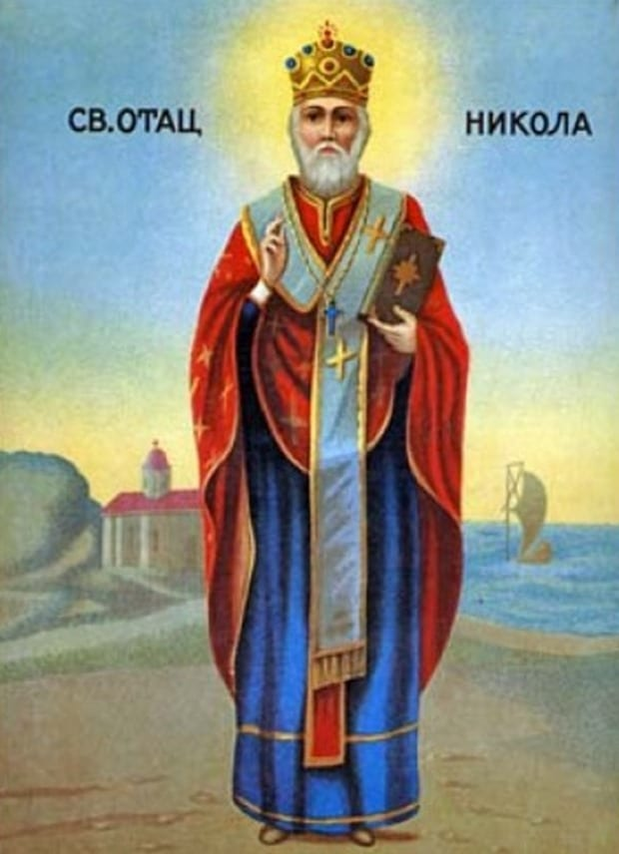
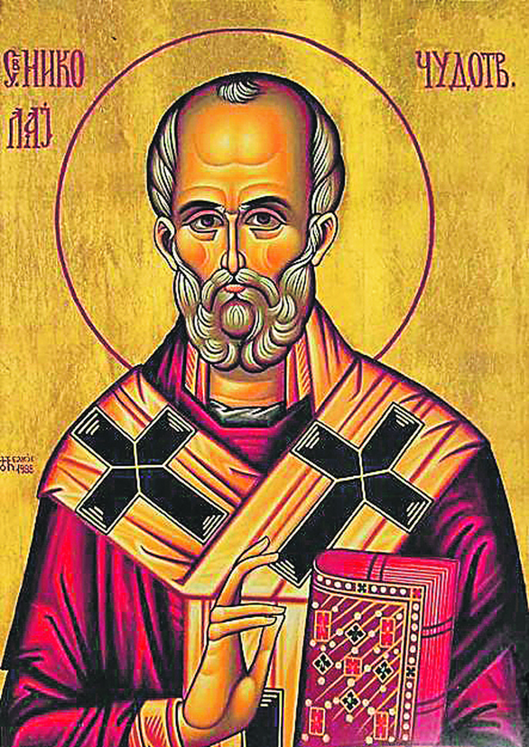
St. Nicholas' Day is a holiday of the Serbian Orthodox Church, which is celebrated on December 19 according to the Gregorian calendar.
SAINT NICHOLAS

Slide 3
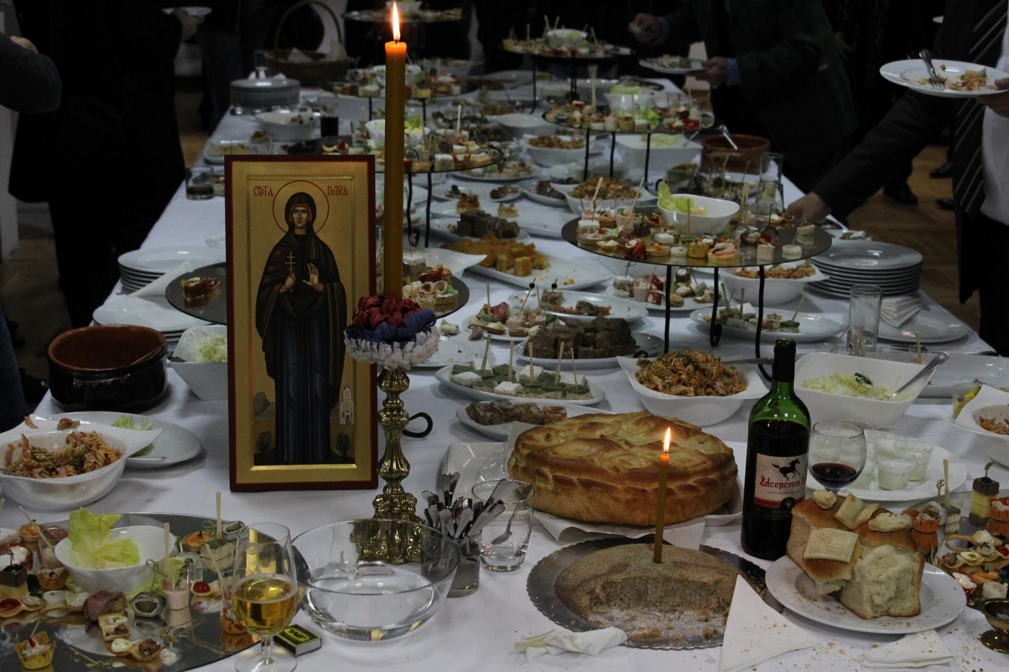
VII2
on the day or on the eve of the celebration,we are going to the church to the liturgy liturgy and the consecration of bread the priest, together with the host, consecrates bread and grain, and then goes home where lunch begins.

Slide 4
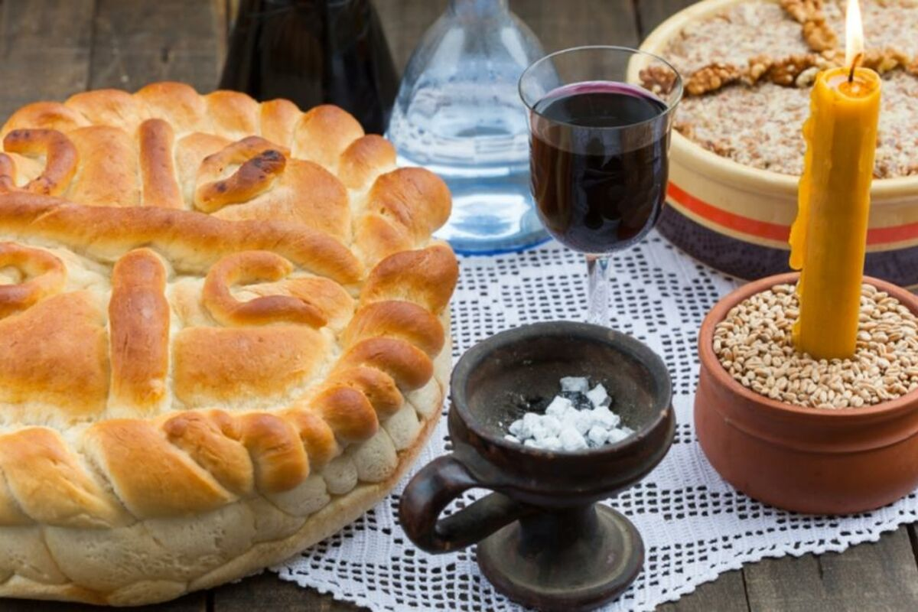
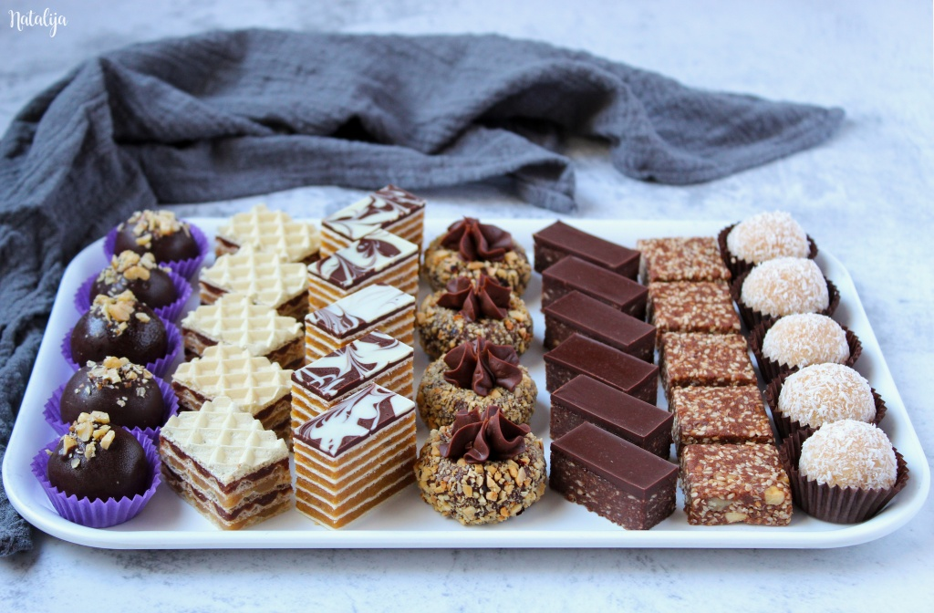
VII2
On the table is a lighted candle,a glass of wine and incense.we usually eats grain befeore lunch and drinks a glass of wine we also eat cakes.

Slide 5
Thanks for watching my beautiful presentation!

